Slide 1
Jonathan Lenoir (CR CNRS)
@jonlen@ecoevo.social
@EkoLogIt
Ecologie et Dynamique
des Systèmes Anthropisés
UMR 7058 CNRS-UPJV
www.u-picardie.fr/edysan
Forest microclimates & forest ecosystems’ adaptation to macroclimate change
Forest in Transitions – 19/06/2024
Université de Tours – France
LiDAR data : Office National des Forêts (ONF) | Illustration : Tarek Hattab

Slide 2
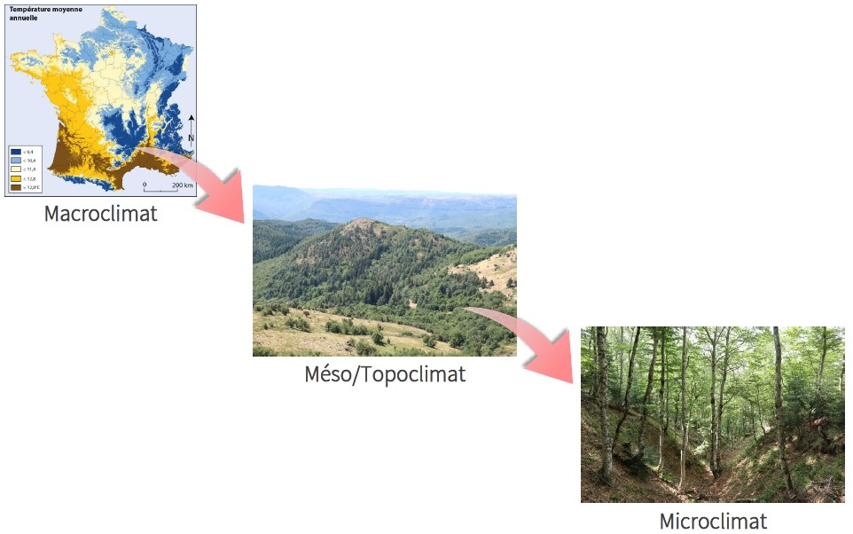
What is microclimate?
A scaling issue?
Macroclimate
Topoclimate
Microclimate
Illustration: Eva Gril | Bioclimatic map of France: Daniel Joly et al. (2010)

Slide 3
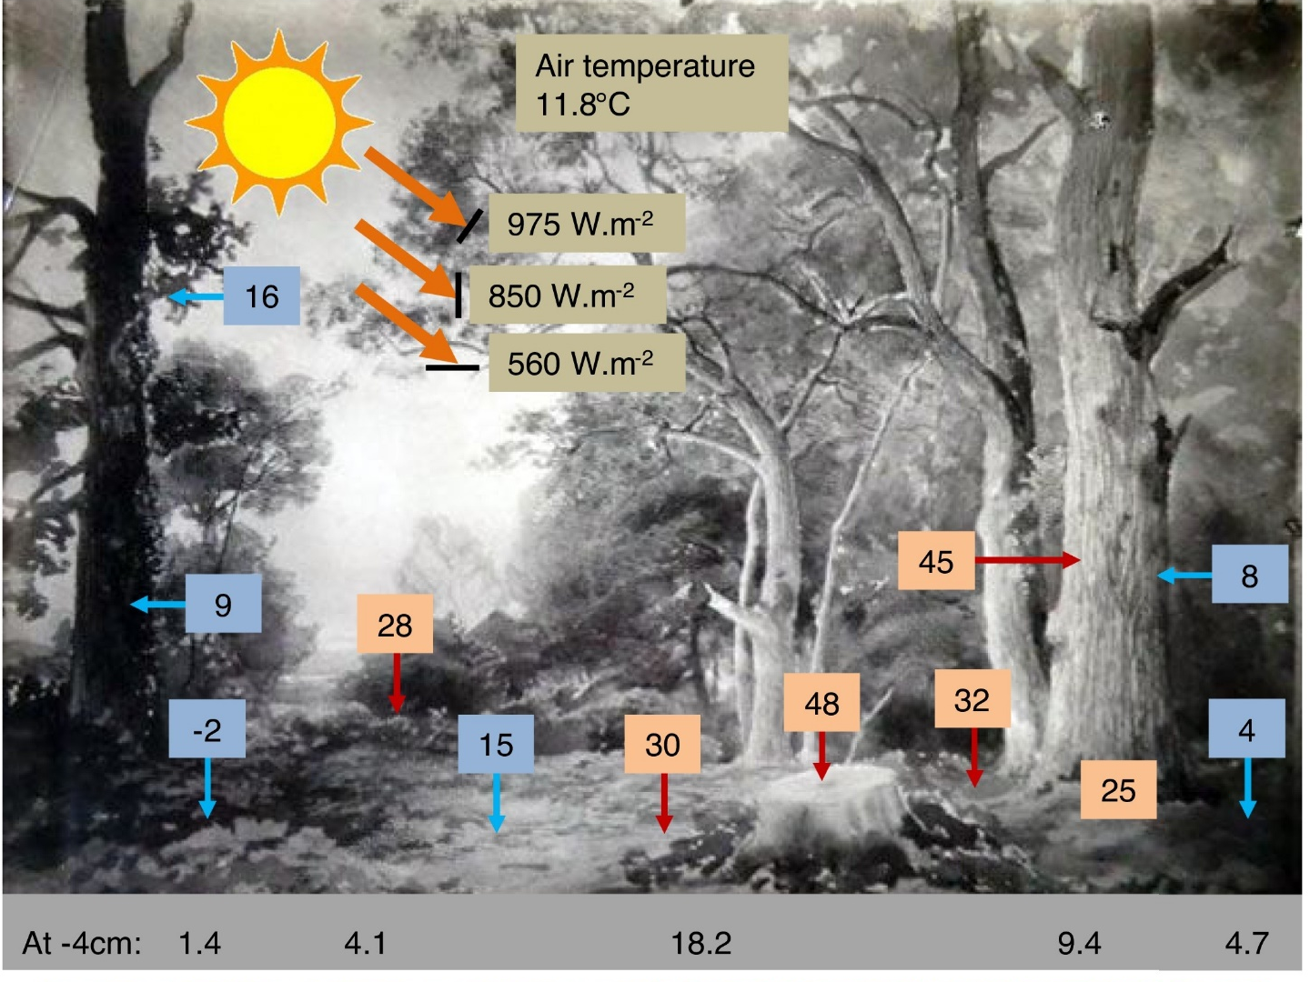
What is microclimate?
Microclimate or microclimates?
Sylvain Pincebourde et al. (2020)

Slide 4
What is microclimate?
Microclimate or microclimates?
Sylvain Pincebourde et al. (2020)

Slide 5
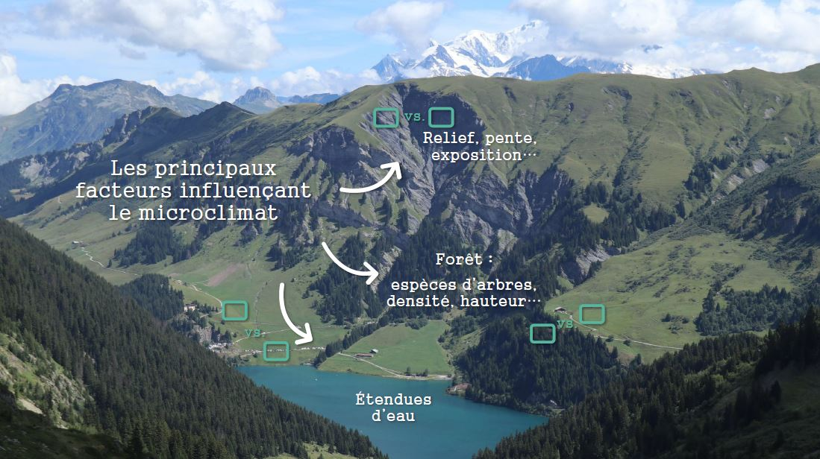
What is microclimate?
What are the main determinants of microclimates?
Illustration: Eva Gril

Slide 6
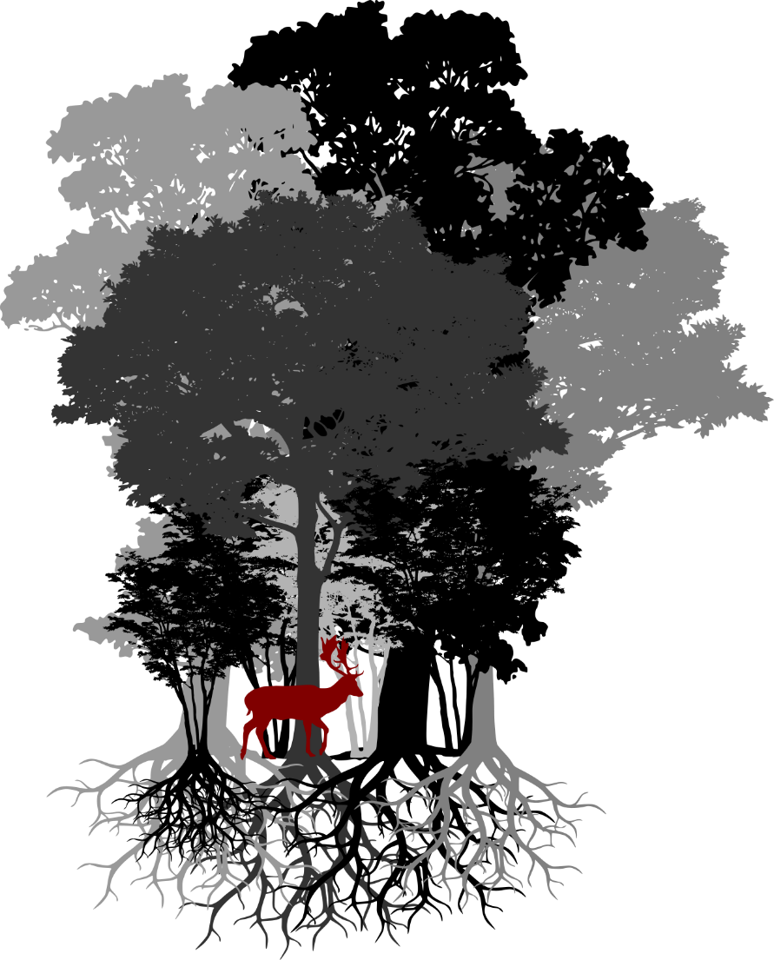
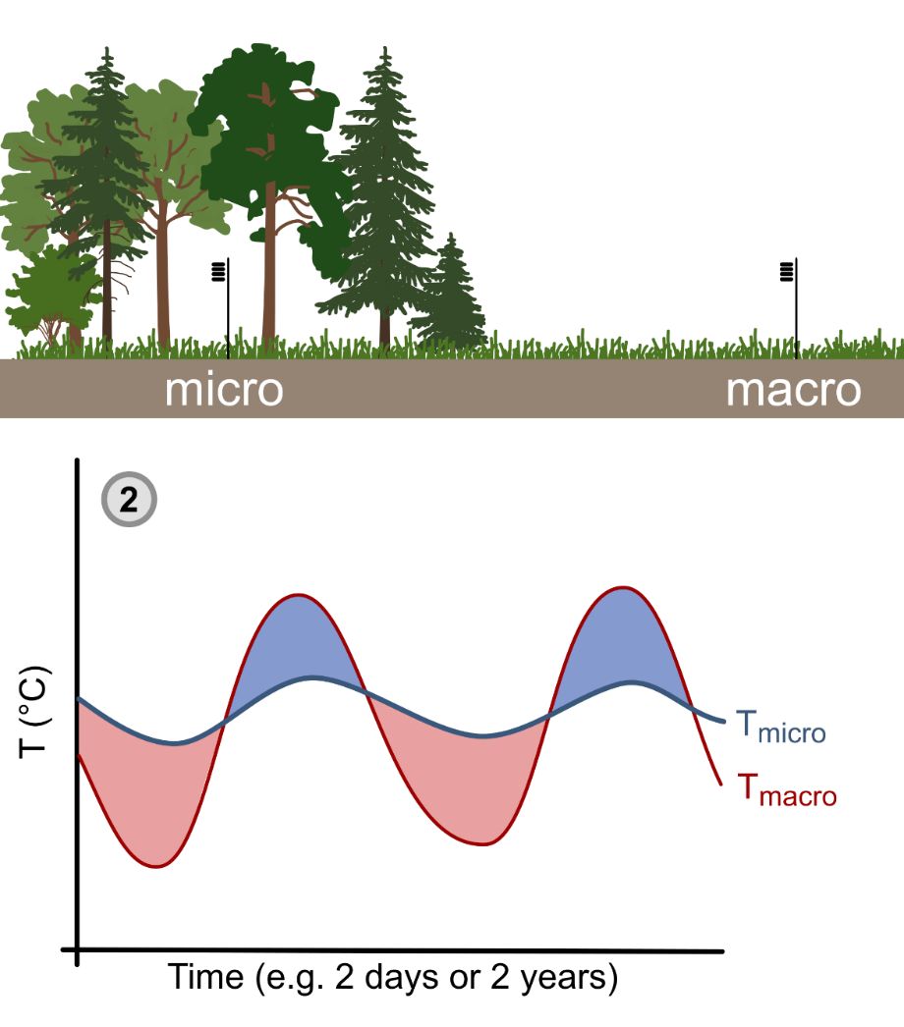
What is microclimate?
The special case of forest microclimates
Pieter De Frenne et al. (2021)

Slide 7
What is microclimate?
Underlying processes:
Canopy shading
Tree transpiration
Wind break
The T°C difference between forest interiors and more open habitats can reach between 2 to 15°C depending on the bioclimatic context, the time of the year and the structural properties of the canopy (maximum height, vertical complexity, canopy density, etc.)
Pieter De Frenne et al. (2021)

Slide 8
How do we measure microclimate?
Typical weather stations do not measure microclimatic conditions as perceived by forest-dwelling organisms
Usually located in fully open landscapes
Systematically located outside forests
T°C measured at 2 to 3 m height
Exposed ton dominant winds
No local shading effect
These stations rather measure macroclimatic or synoptic conditions by avoiding any potential microclimatic effect that may, at best, add noise but usually bias the monitoring of macroclimatic fluctuations
Pieter De Frenne & Kris Verheyen (2016) | Photo: Fabien Spicher

Slide 9
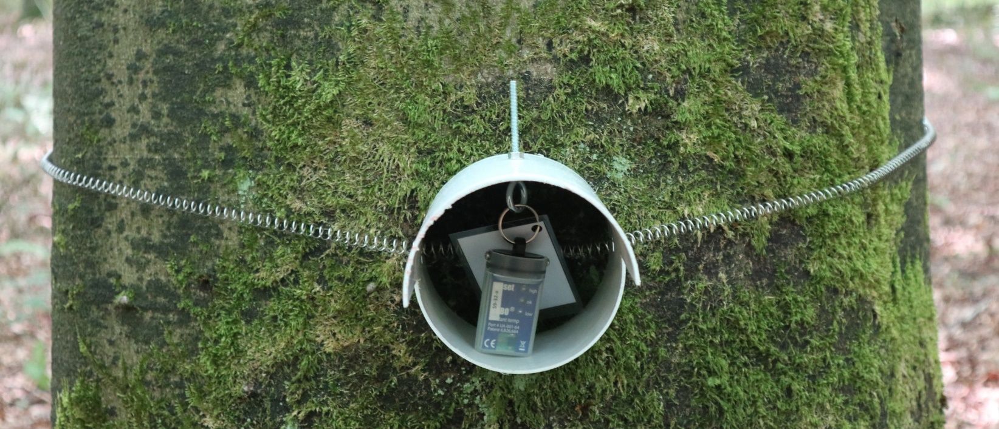
How do we measure microclimate?
To measure forest microclimates and the buffering effect of the canopy on understory T°C, we can use microclimate loggers
Photo: Fabien Spicher

Slide 10
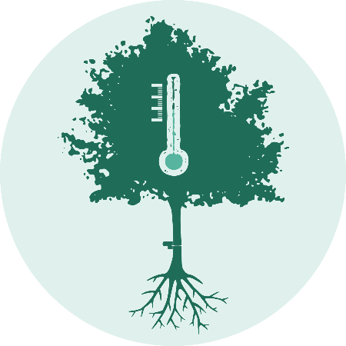
How do we measure microclimate?
The IMPRINT project: Impacts of Microclimatic Processes on foRest bIodiversity redistributioN under macroclimaTe warming
Photos: Eva Gril | IMPRINT Logo: Eva Gril | Website: https://microclimat.cnrs.fr/

Slide 11
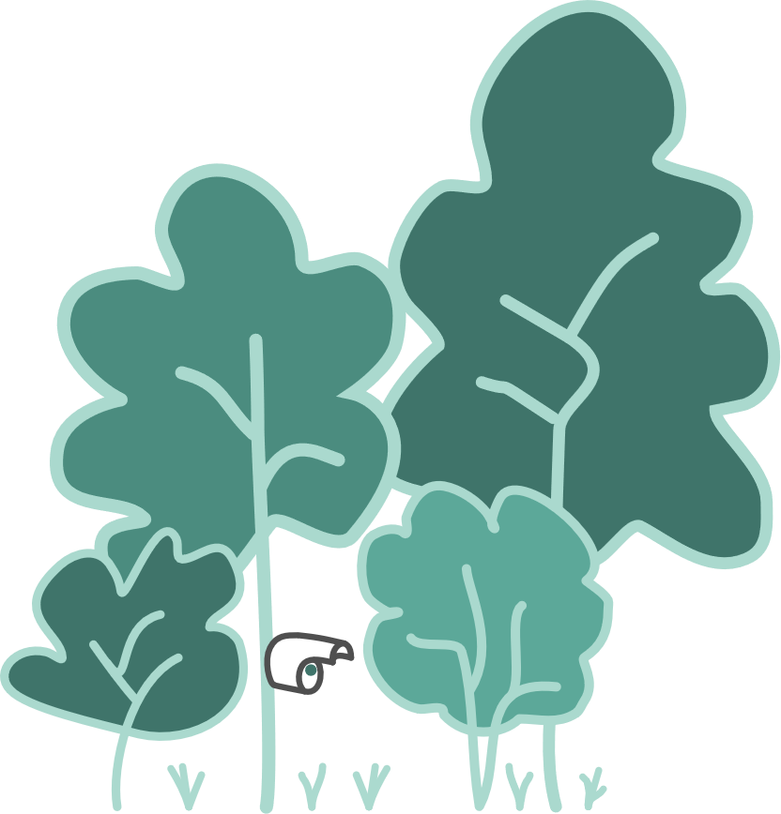
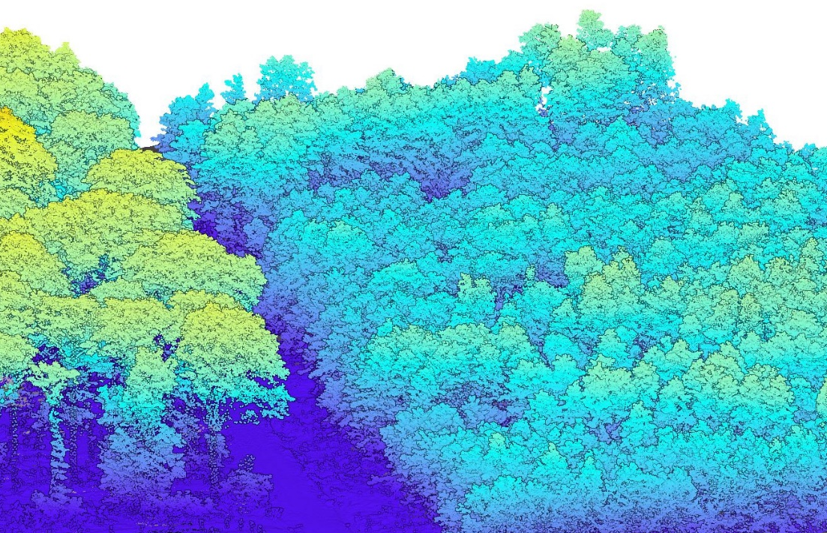
How do we measure microclimate?
Three state forests in France, 60 forest plots per state forest & airborne LiDAR data covering each forest (summer 2021, 70 pts/m²)
Eva Gril et al. (2023) | Maps: Emilie Gallet-Moron | LiDAR data: ALTOA

Slide 12
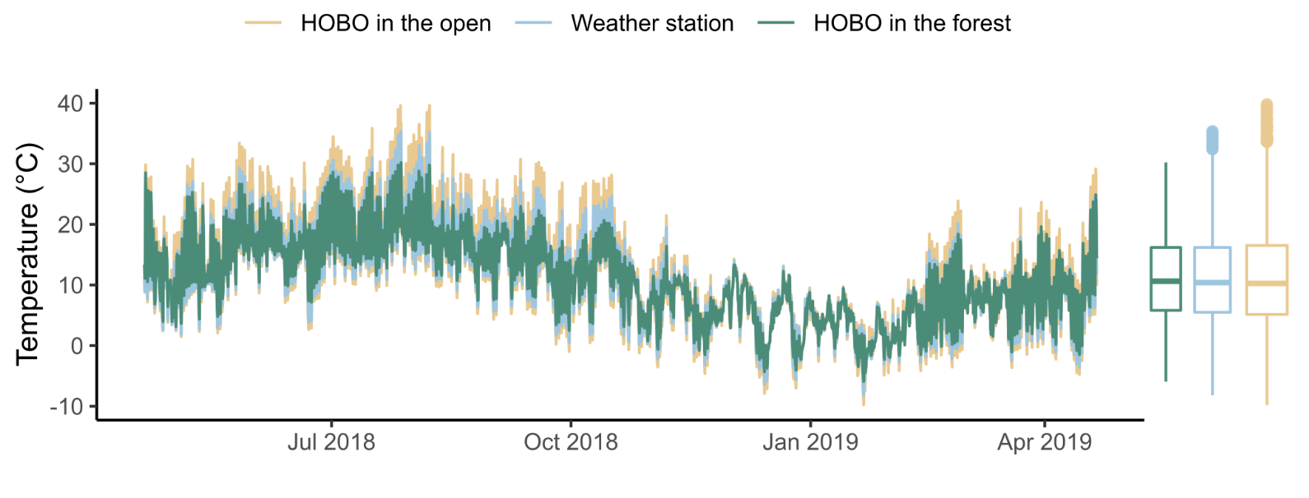
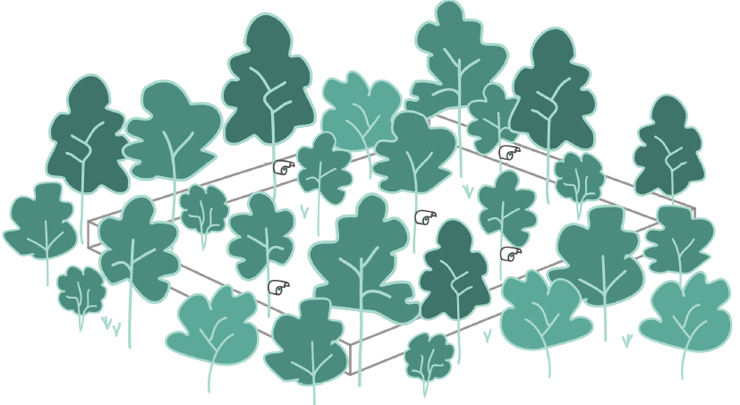
How do we measure microclimate?
A paired design of T°C time series from microclimate data loggers (HOBO) coupled with T°C time series from weather stations
Eva Gril et al. (2023)

Slide 13
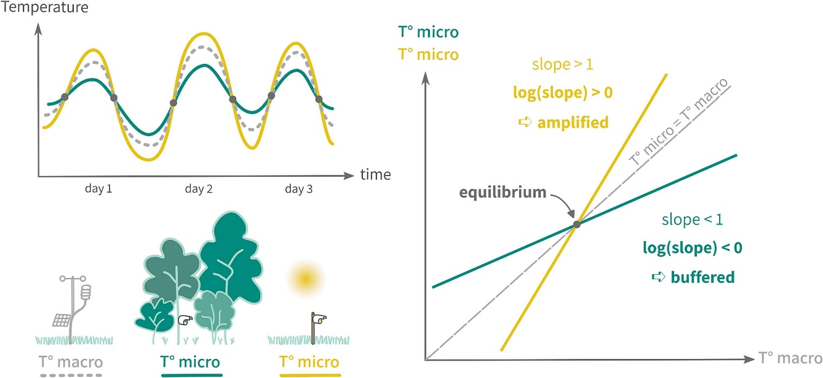
How to model forest microclimates?
For each data logger, we extracted the slope (b) and equilibrium (a/(1-b)) parameters of the model: T°C micro = a + b × T°C macro
Eva Gril et al. (2023) | LiDAR data: ALTOA

Slide 14
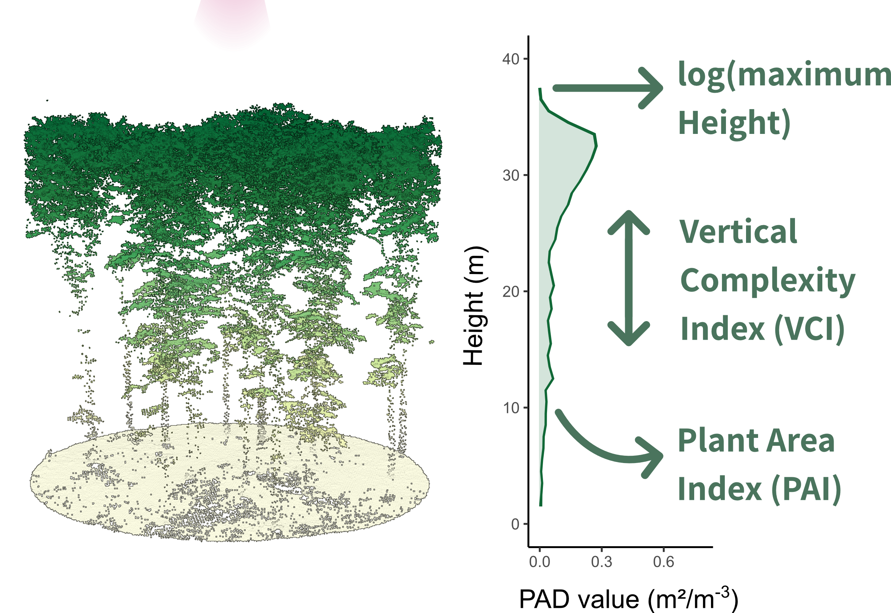
How to model forest microclimates?
Then we used LiDAR-derived variables describing canopy structure to predict & map the log(slope) parameter at fine spatial resolution
Eva Gril et al. (2023)

Slide 15
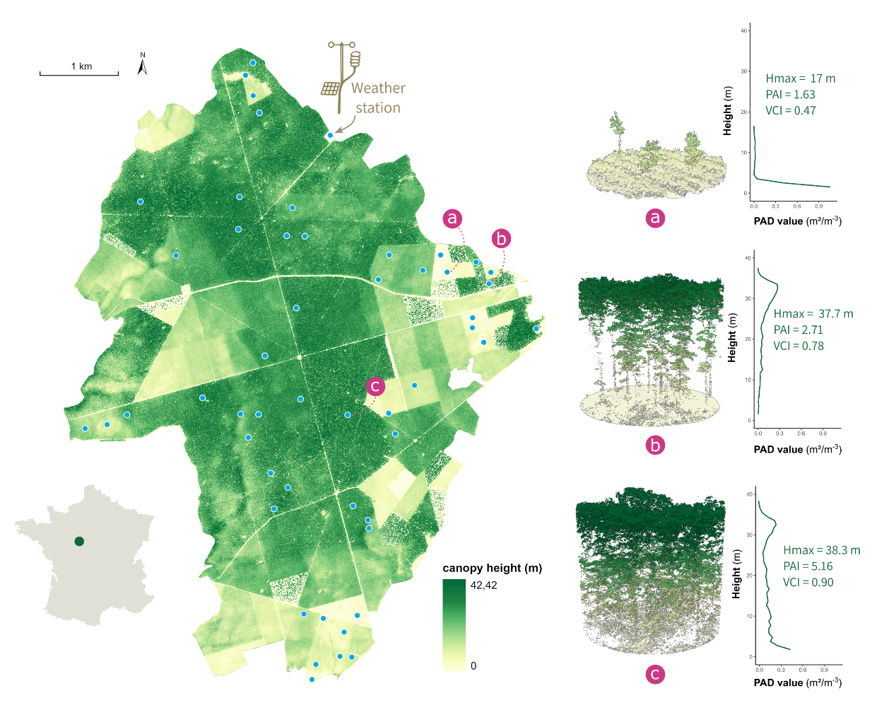
How to model forest microclimates?
Three variables to capture the buffering effect of the canopy!
Eva Gril et al. (2023)

Slide 16
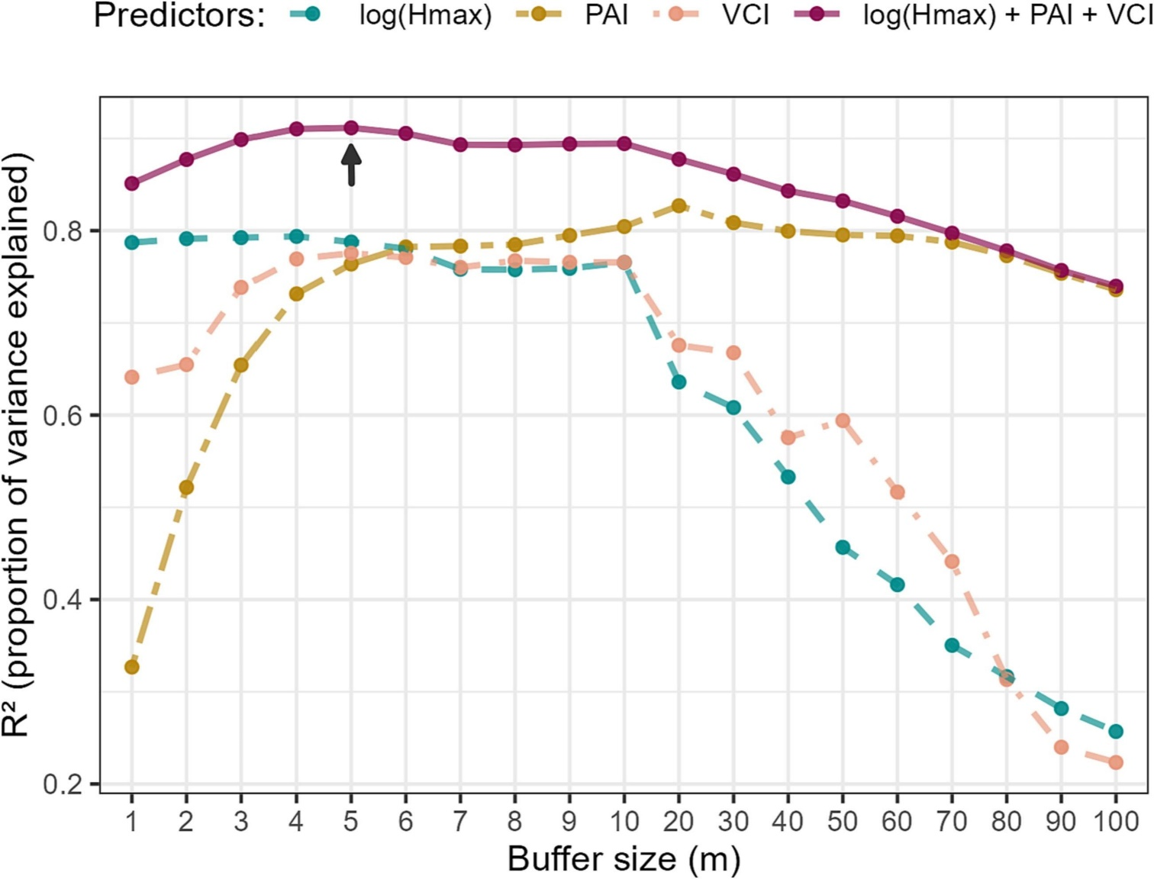
How to model forest microclimates?
Defining the optimal radius to capture the buffering effect
Eva Gril et al. (2023)

Slide 17
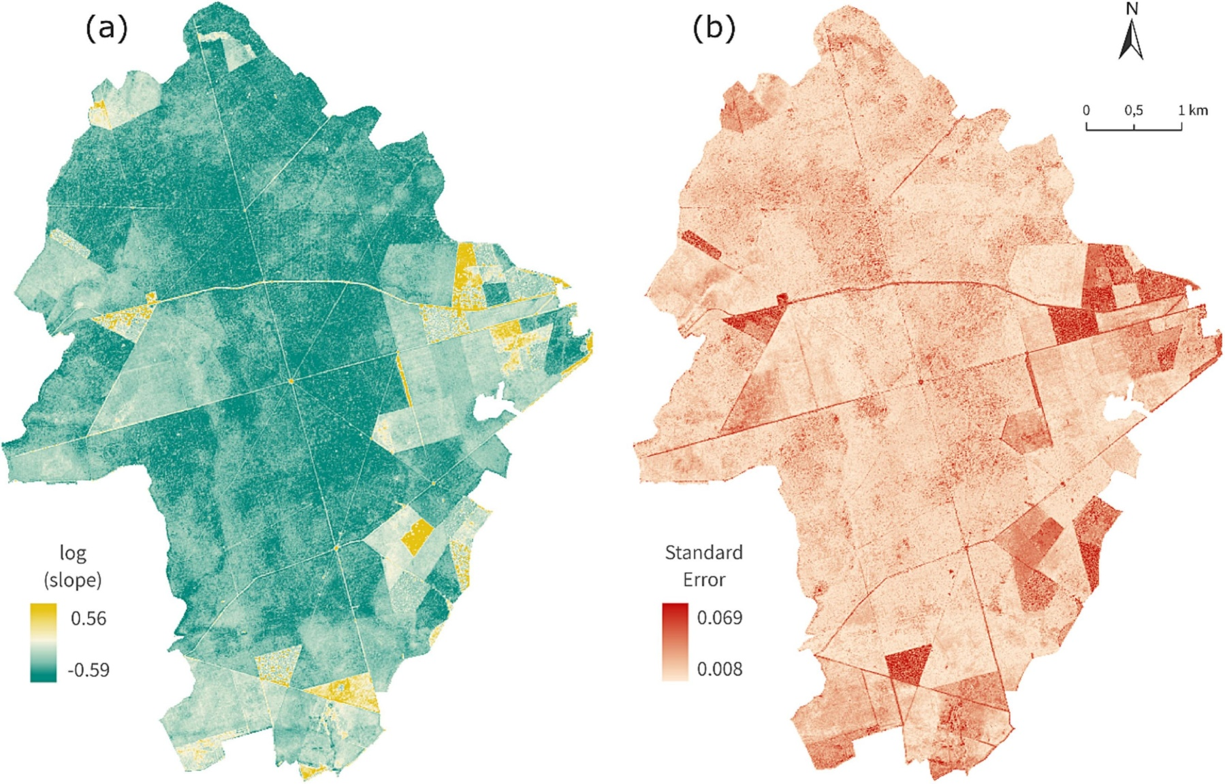
How to model forest microclimates?
Mapping the log(slope) parameter at 10-m resolution
v
v
Eva Gril et al. (2023)

Slide 18
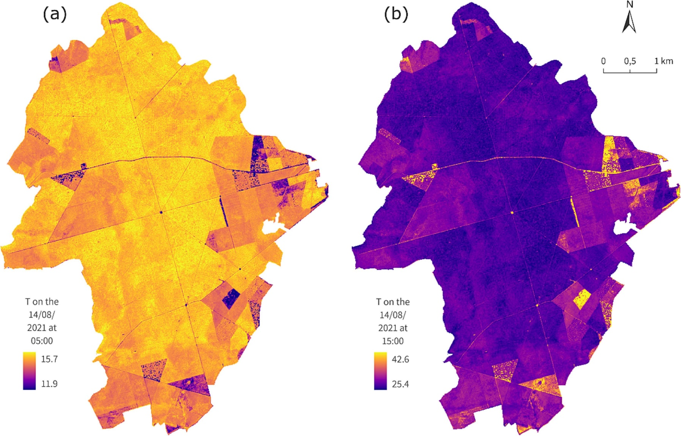
How to model forest microclimates?
T°C at 10-m resolution on August 14th 2021 at 5AM & 3PM
v
v
T°C = 14,3°C
T°C = 31,8°C
Eva Gril et al. (2023)

Slide 19
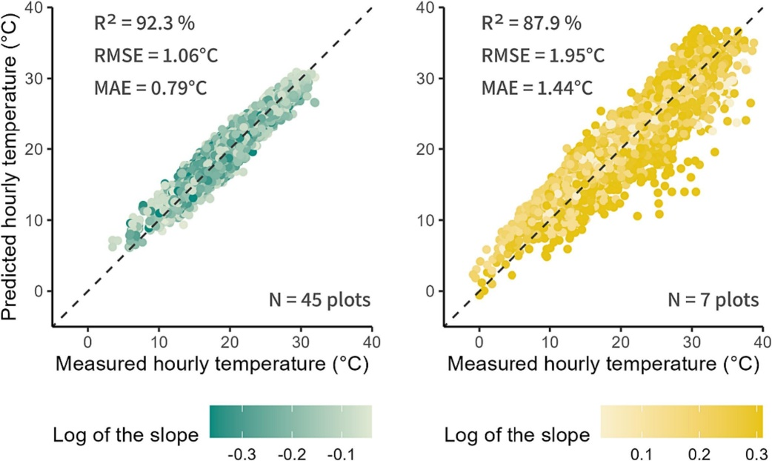
How to model forest microclimates?
Quality of model predictions in closed-canopy vs. open forests
Eva Gril et al. (2023)

Slide 20
Why do we need to account for microclimate?
Generating maps of forest microclimates at fine spatiotemporal resolutions has numerous advantages and potential uses:
Improving predictions from species distribution models
Identifying potential micro-refugia harbouring stable conditions
Mapping thermal corridors for species migration as climate warms
Improving our knowledge of tree seedling establishment success
Anticipating microclimate changes from management practices
Optimizing management practices for microclimate sustainability
Anticipating fire risks during heatwaves and drought events
Eva Gril (2024)

Slide 21
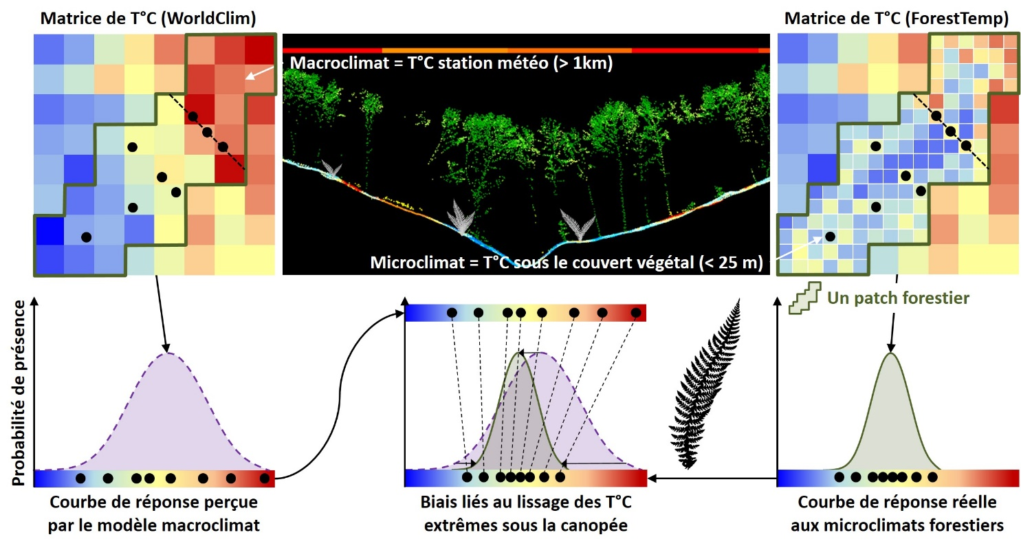
Why do we need to account for microclimate?
A distorstion of the climatic niche for understory species
Jonathan Lenoir et al. (2017) | Stef Haesen et al. (2023)

Slide 22
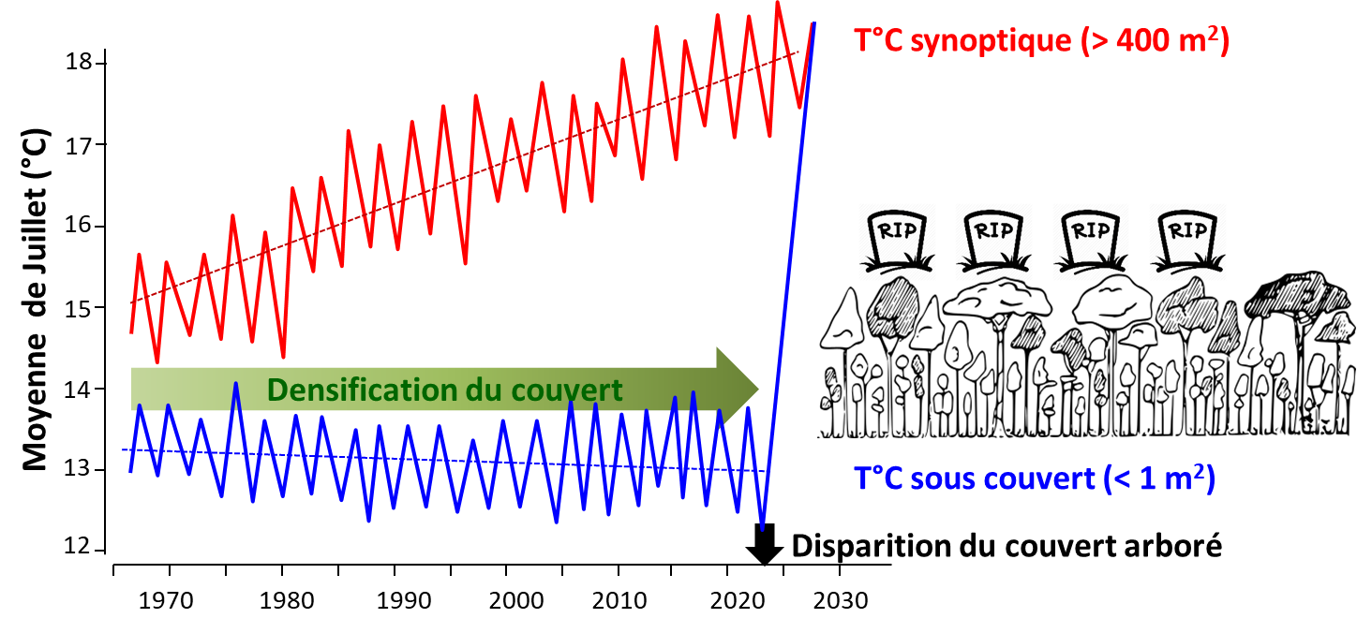
Forest microclimates & climate change?
What is the fate of forest microclimates under anthropogenic climate changes with more severe and frequent climatic extremes?
Increasing risk of forest dieback induced by drought events
More open canopies due to more intensive forest harvesting
A risk to slow down the buffering capacity of tree canopies
Increasing risks for amplified T°C extremes in the understory
Higher local extinction risks for forest specialist species
Jonathan Lenoir et al. (2017)

Slide 23
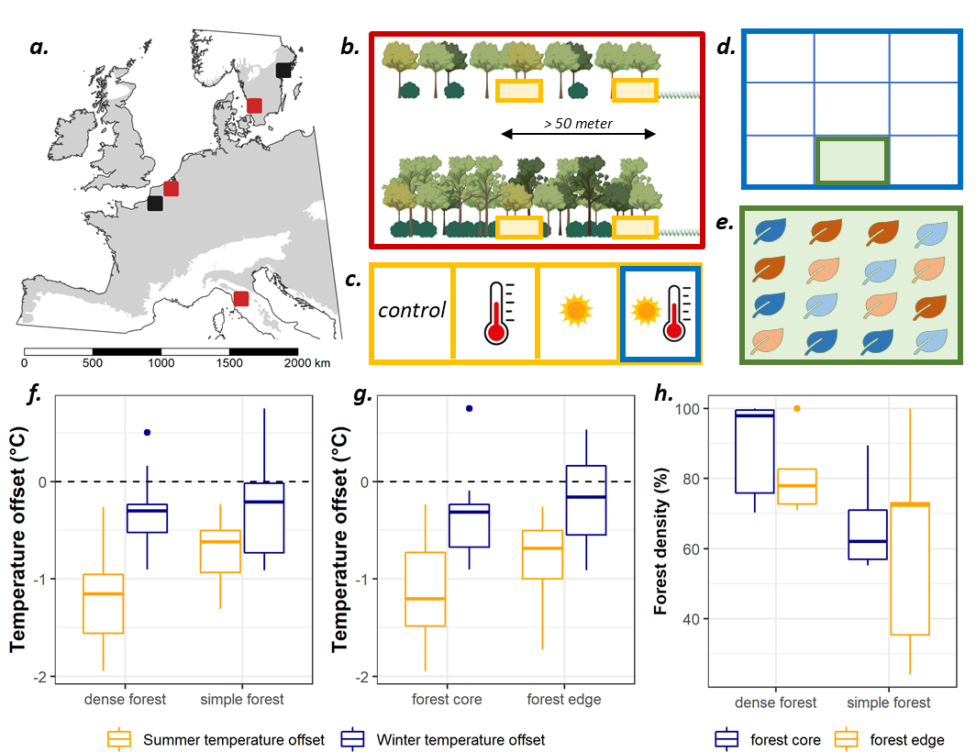
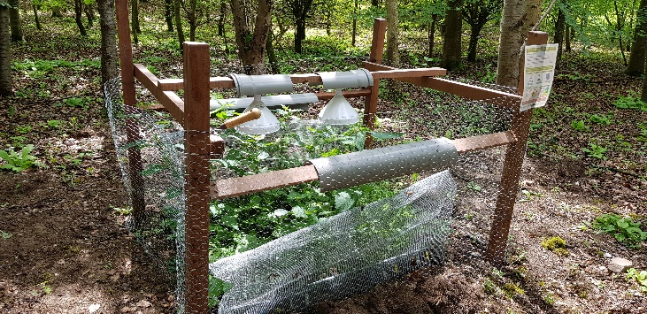
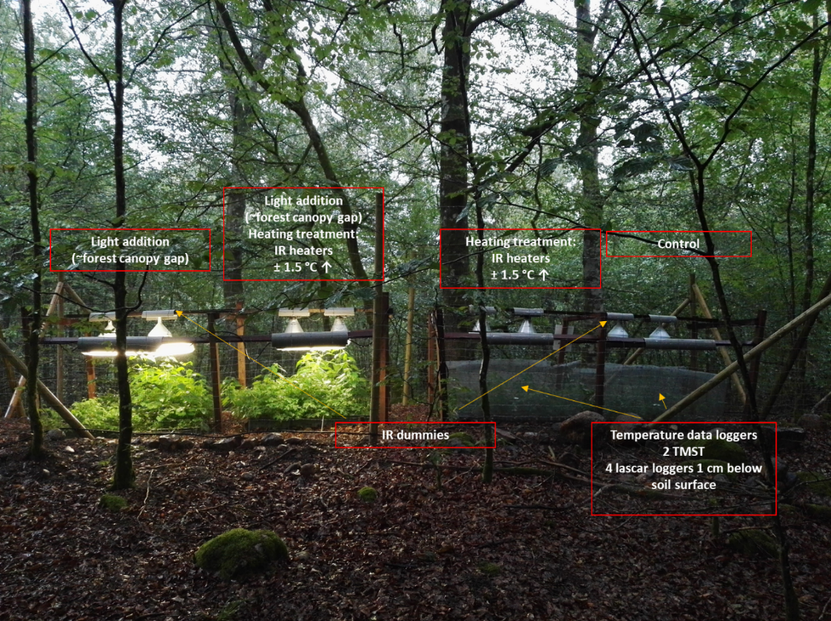
Forest microclimates & climate change?
A large transplant experiment of 12 understory plant species along combined gradients of canopy closing & understory warming
Pieter Sanczuk et al. (2023)

Slide 24
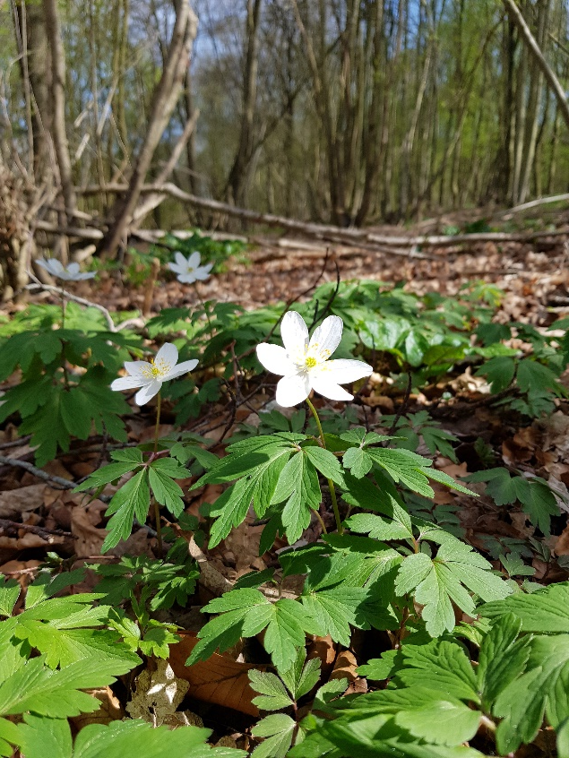
Forest microclimates & climate change?
25997 measures of demographic parameters (survival rate, growth rate, flowering success, seed production) for 8064 transplants of 12 species to feed a demographic model of population growth rate (λ)
Pieter Sanczuk et al. (2023)

Slide 25
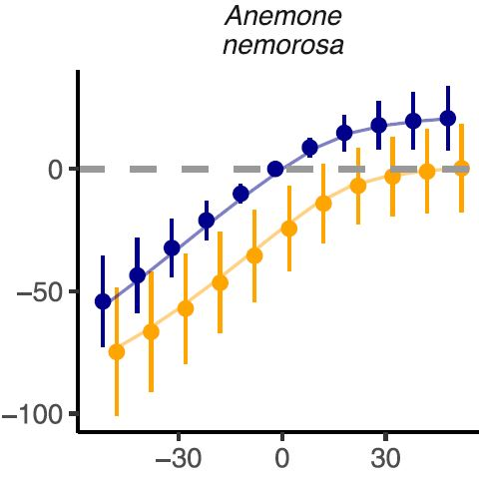
Forest microclimates & climate change?
Canopy density matters for the population growth rate λ
A 50% reduction in canopy density may induce a 75% decrease in the population growth rate of wood anemone by 2070, under the most extreme climate warming scenario (RCP 8.5)
By contrast, a 50% increase in canopy density can mitigate up to 92% of the negative impacts of climate warming under the most extreme scenario (RCP 8.5)
Pieter Sanczuk et al. (2023)

Slide 26
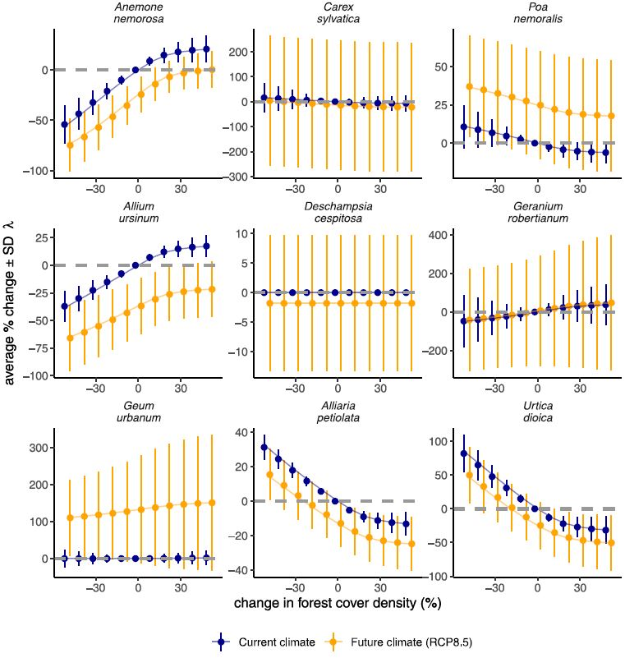
Forest microclimates & climate change?
Results for 8 other species:
For common nettle (Urtica dioica), a generalist species, we found opposite trends such that a 50% reduction in canopy density can induce a 50% increase in the population growth rate of that species by 2070 under the most extreme scenario (RCP 8.5)
Pieter Sanczuk et al. (2023)

Slide 27
Conclusions
We need to adapt forest management practices:
If foresters cannot act directly to curb the climate warming trend, they can act on forest microclimates by sustaining healthy microclimatic processes in the understory through active forest management practices that favour a continuous canopy cover
By applying continuous cover forestry principles, foresters can help maintaining the buffering capacity of the canopy and thus more stable microclimatic conditions in the understory that may increase the chances of population survival for forest specialist species under anthropogenic climate change

Slide 28
Jonathan Lenoir (CR CNRS)
@jonlen@ecoevo.social
@EkoLogIt
Ecologie et Dynamique
des Systèmes Anthropisés
UMR 7058 CNRS-UPJV
www.u-picardie.fr/edysan
Forest microclimates & forest ecosystems’ adaptation to macroclimate change
Forest in Transitions – 19/06/2024
Université de Tours – France
LiDAR data : Office National des Forêts (ONF) | Illustration : Tarek Hattab

Slide 29
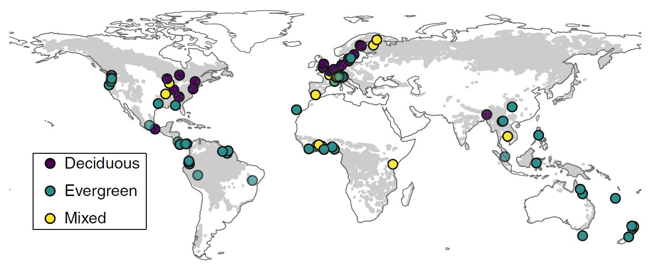
Comment mesure t-on le microclimat ?
Revue de la littérature scientifique sur l’effet tampon des forêts
Un total de 98 sites avec un dispositif apparié de 714 mesures de T°C sous-couvert vs. hors-couvert forestier
Pieter De Frenne et al. (2019)

Slide 30
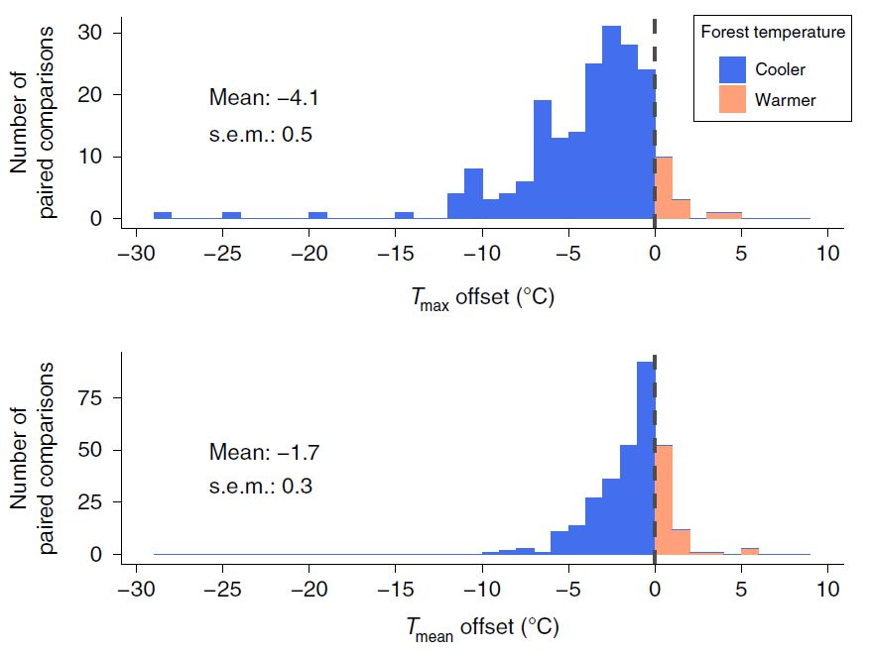
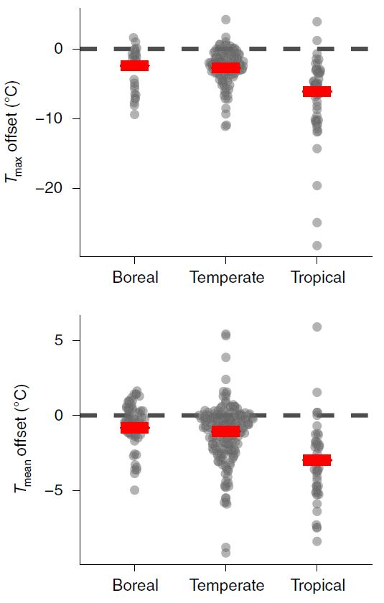
Comment mesure t-on le microclimat ?
Résultats de la différence T°C hors-couvert moins T°C sous-couvert
Un effet tampon plus prononcé en contexte tropical
Pieter De Frenne et al. (2019)

Slide 31
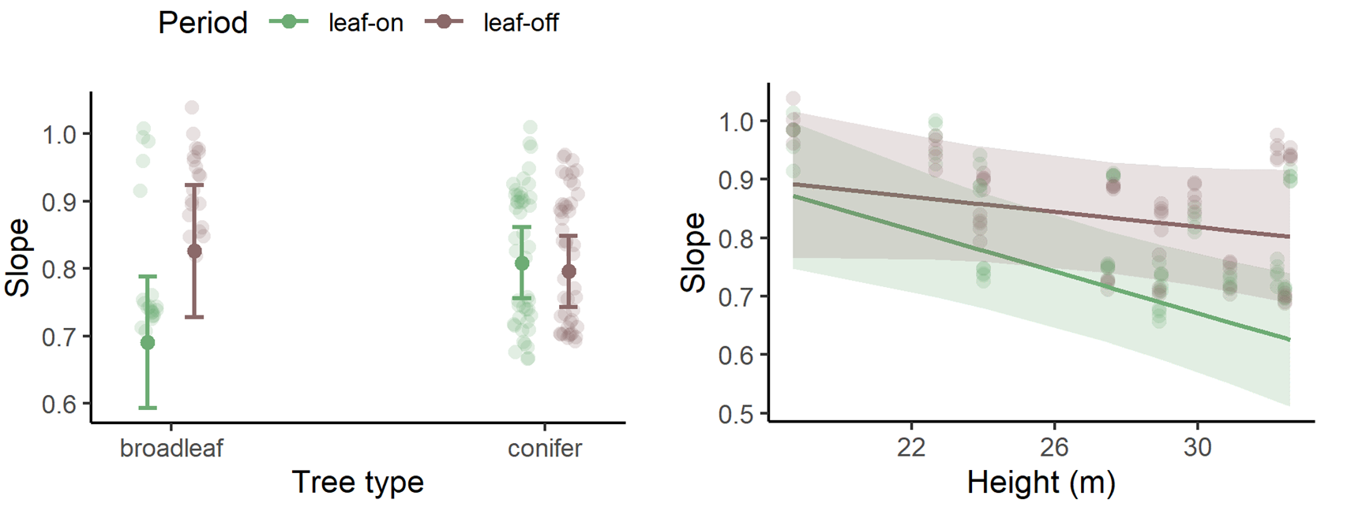
Comment modéliser le microclimat forestier ?
Le paramètre de pente dépend surtout des conditions structurelles du peuplement forestier (essence, hauteur, densité de couvert, etc.)
Eva Gril et al. (2023)

Slide 32
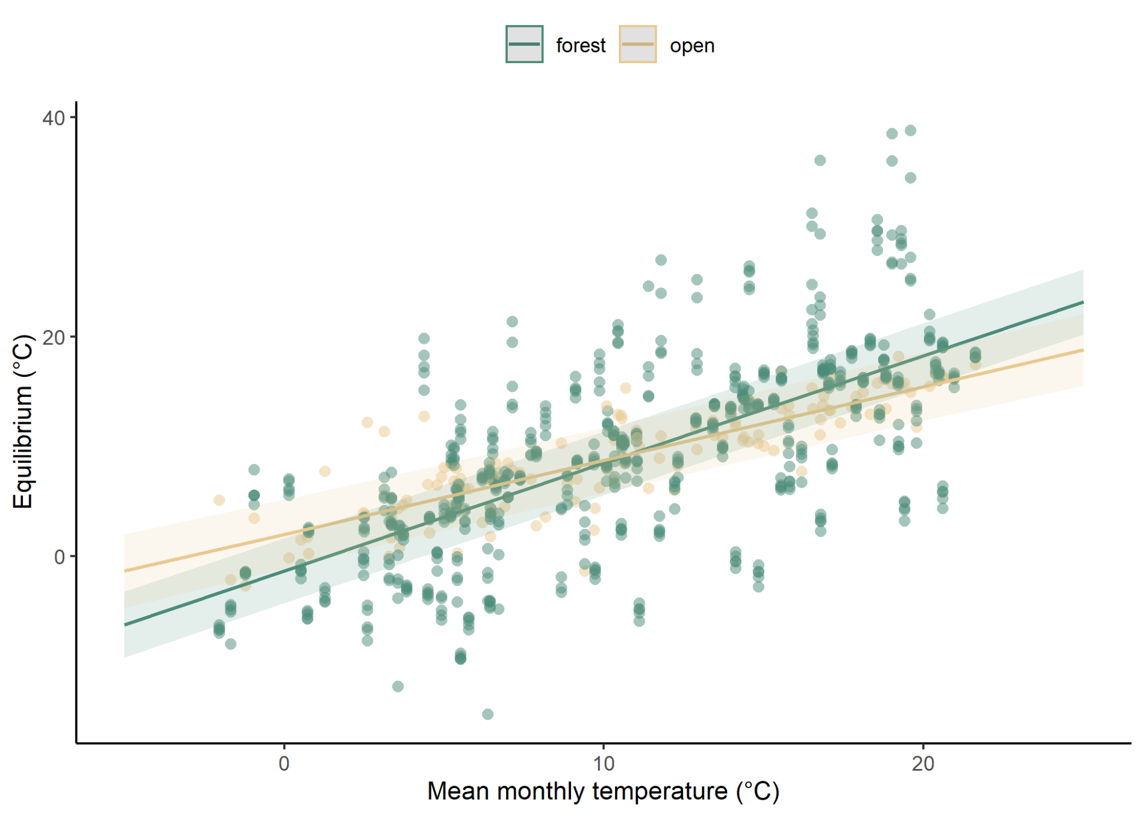
Comment modéliser le microclimat forestier ?
Tandis que le paramètre d’équilibre dépend surtout des conditions macroclimatiques générales et de la saisonnalité
Eva Gril et al. (2023)

Slide 33
La question du réchauffement climatique global ?
Non ! Mais alors, est-ce que le réchauffement ressenti hors-couvert est vraiment différent et atténué sous-couvert ? Cela dépend !
En cas d’ouverture des peuplements, le réchauffement est amplifié sous-couvert par rapport à la situation classique hors-couvert
En cas de fermeture du couvert, le réchauffement est atténué sous-couvert par rapport à la situation hors-couvert
Florian Zellweger et al. (2020)

Slide 34
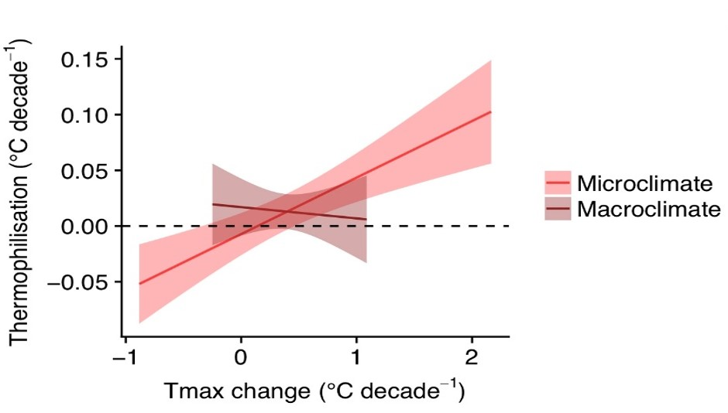
La question du réchauffement climatique global ?
Par conséquent, les communautés végétales de nos sous-bois changent mais en réponse aux changements microclimatiques !
Florian Zellweger et al. (2020)

